Slide 1
What Counties are Leading the EV Sales
A Data Story about the Global EV Takeover
Dean Chen 2/1/2023

Slide 2
Introduction
The sales of electric vehicles had exceeded 10 million for the first time in 2022
The sales are expected to grow even stronger in 2023, around 14 million
This presentation uses data to investigate which countries are contributing most to the takeover of electric vehicles.

Slide 3
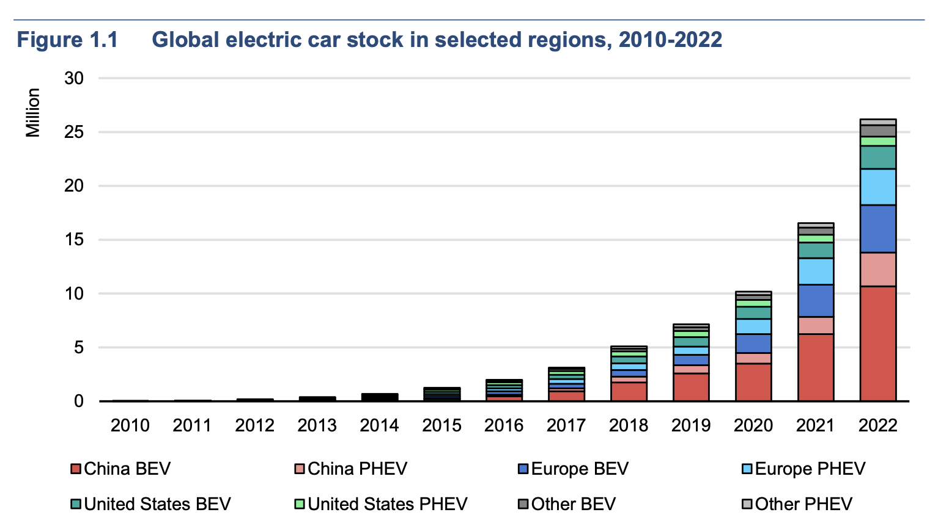
Global electric car stock in selected regions, 2010-2022

Slide 4
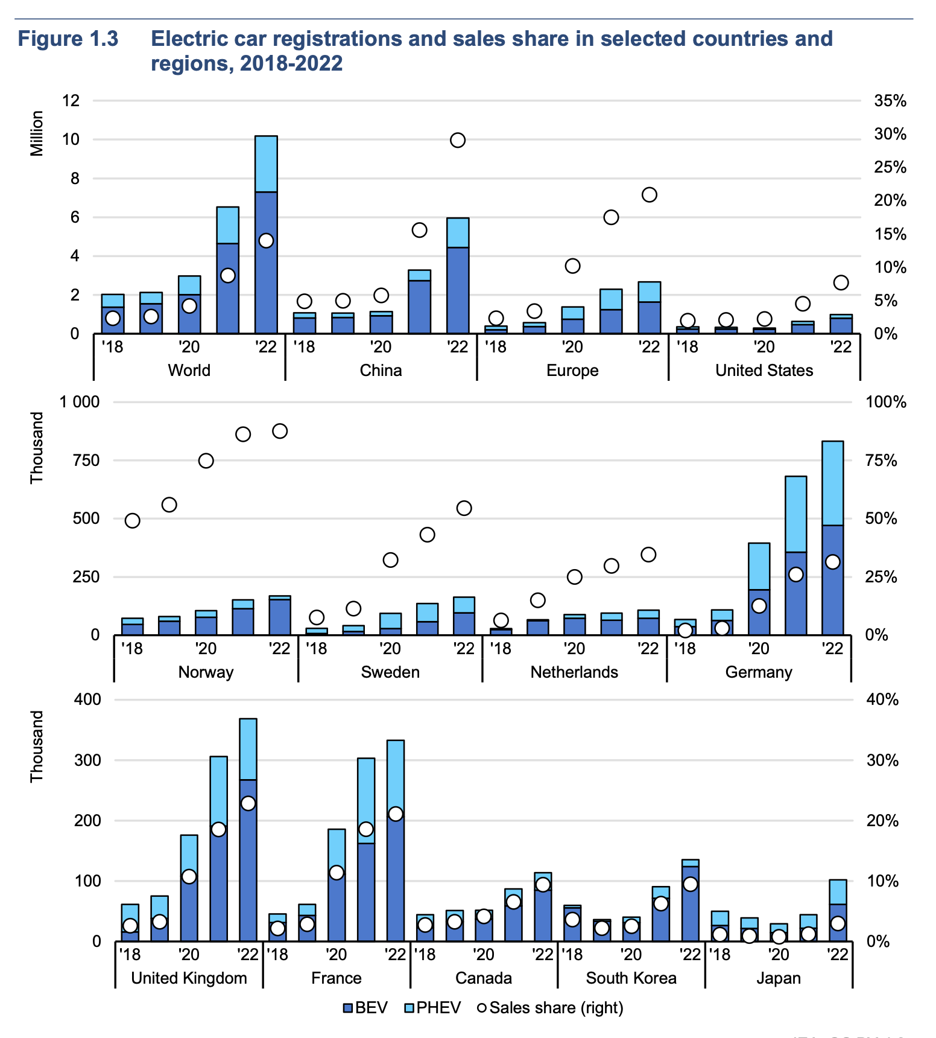
Electric car registrations and sales share in selected countries and regions, 2018-2022

Slide 5
The Chinese Market

Slide 6
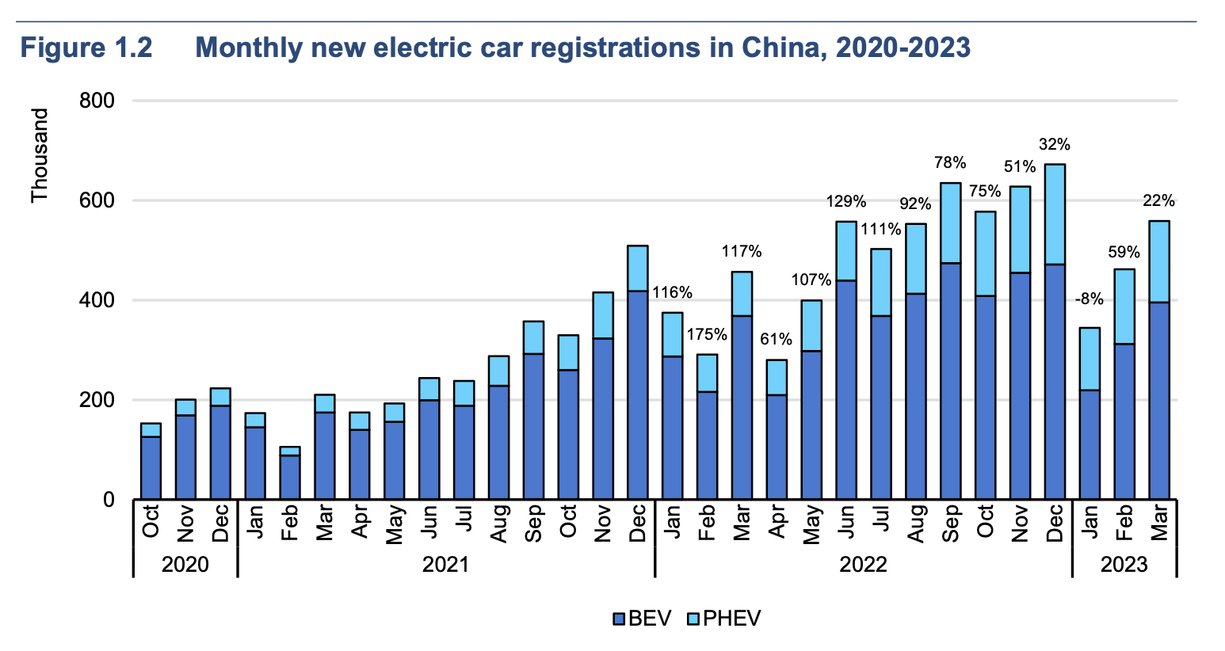
Electric car sales in China have been steadily increasing since 2020, but future trends will warrant further examination given that purchase incentives ended in 2022.

Slide 7
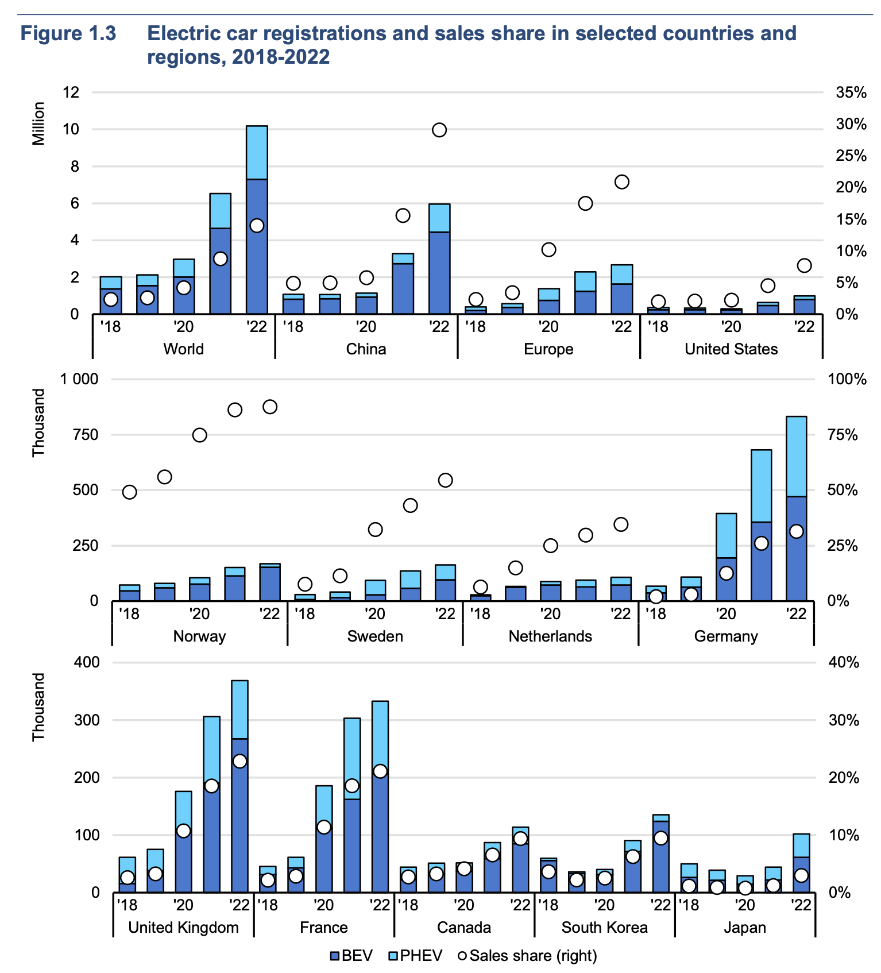
Other Countries’s EV Sales
Japan, considering it’s significant personal vehicle ownership, is lagging behind the rest of the world

Slide 8
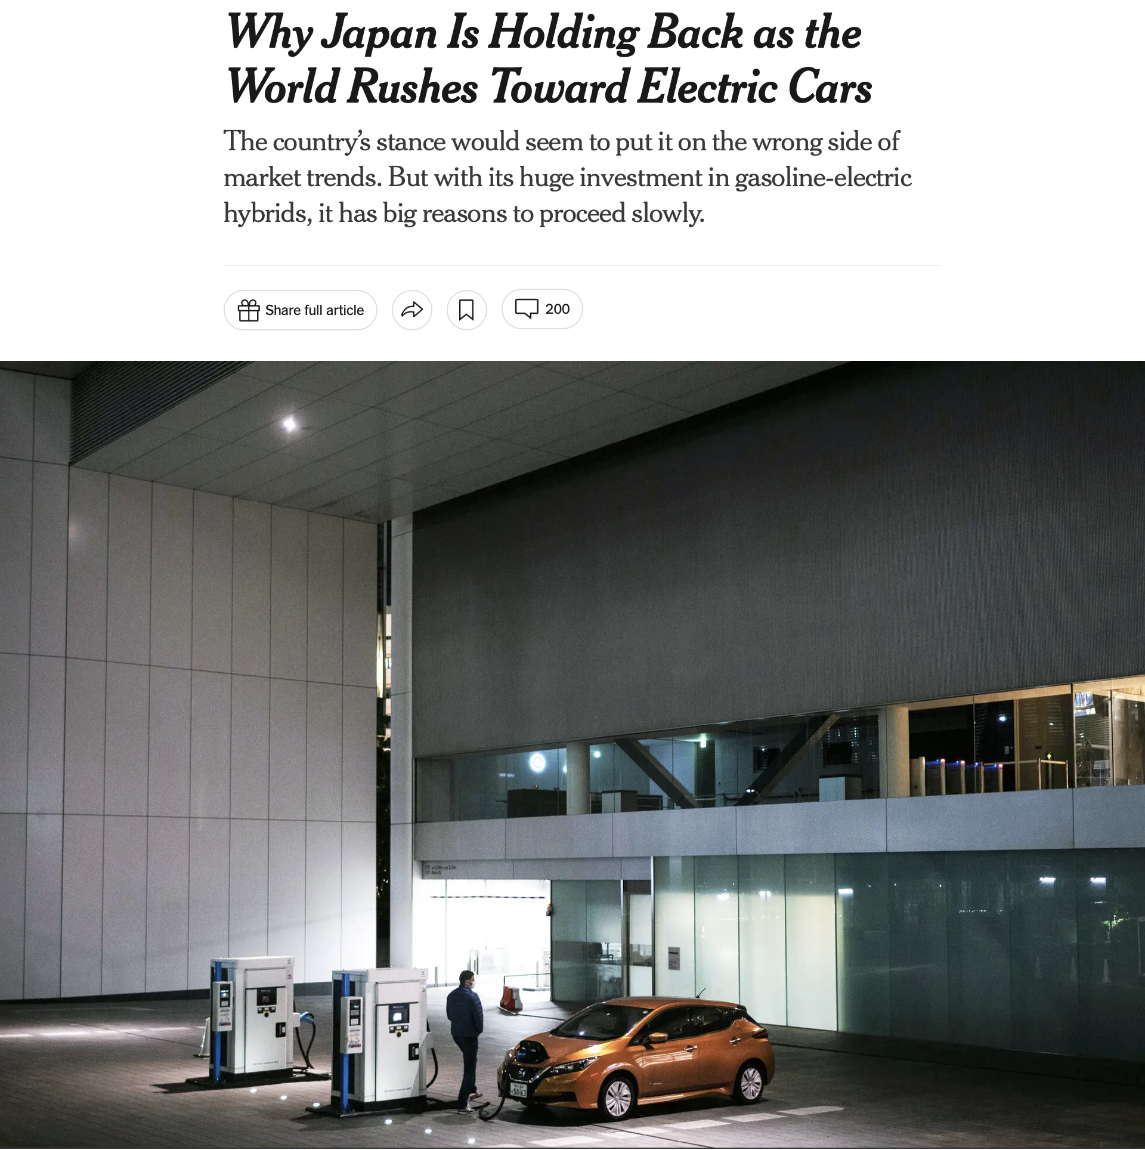

Slide 9
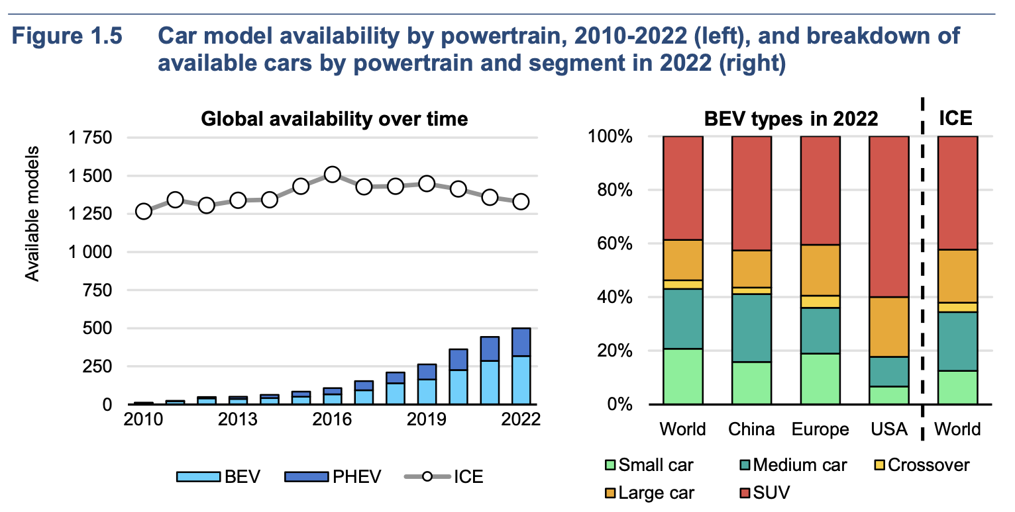
What Size of EVs Does Each Country Prefer?

Slide 10
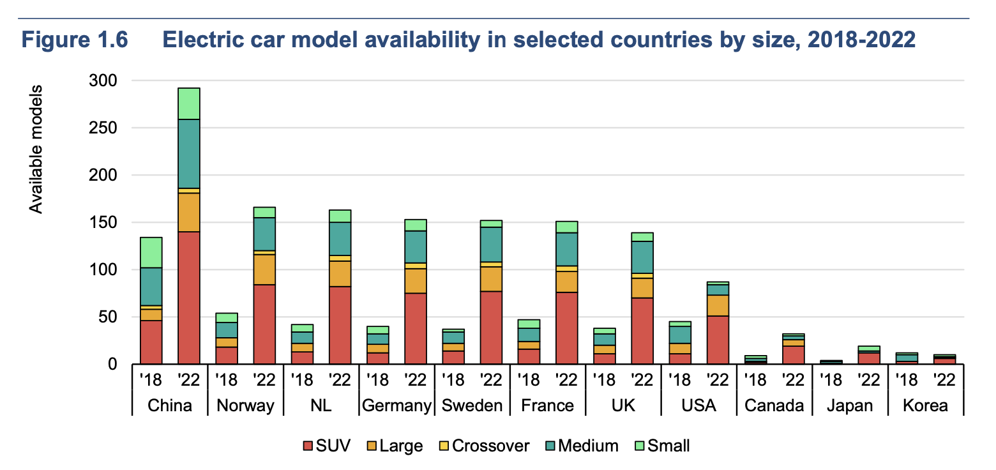
SUVs Still Dominate the Market

Slide 11
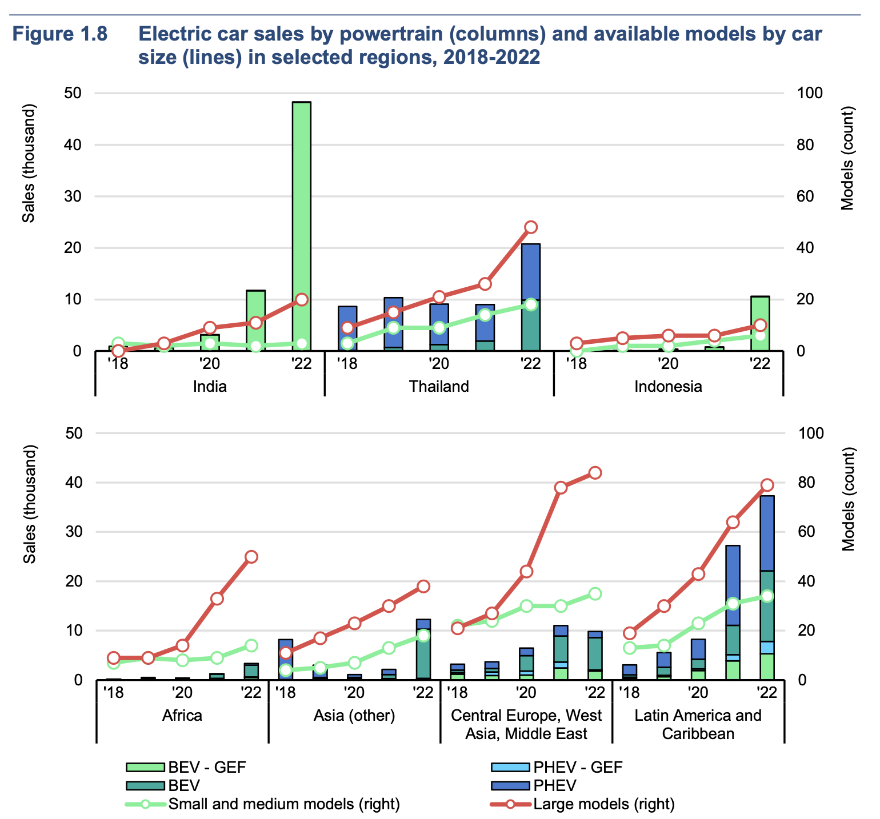
Emerging Markets’ EV Appetite

